Slide 1
Bonding

Slide 2
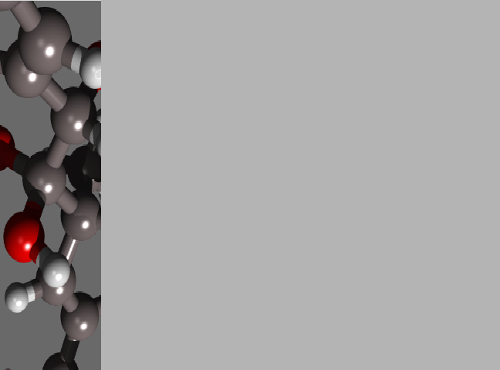
Review
You already know the structure of an atom and how to figure these characteristics out.
  Protons
  Neutrons
  Electrons
  Rings
  Electron distribution
  Valence electrons
  Bohr Models
  Lewis Structures

Slide 3
Atoms: Subatomic Particles
The atom is composed of three main types of smaller “subatomic” particles in two regions…
(p+) Protons: positively charged particles.
(n°) Neutrons: particles with no charge.
(e-) Electrons: negatively charged particles.
Electron Cloud:
Electrons orbit the nucleus in a cloud in orbitals.
Nucleus:
Where the protons and neutrons are.

Slide 4
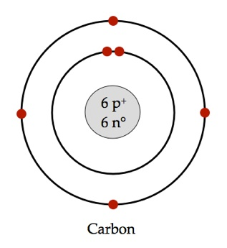

Representing the Atom
Bohr’s Diagram
  Shows the nucleus, all energy levels, and electron distribution.
Lewis Structure
  Shows the atomic symbol & valence e-.
  Shows the nucleus (with p+ & n°) plus all inner energy levels (& electrons) represented by the atomic symbol.
  Usually the easiest one to use.

Slide 5
This Unit…
We’re now going to learn how atoms interact with each other
Bonding
  Ionic
  Covalent
Chemical reactions
Balancing chemical equations

Slide 6
Terminology
  Some terms you should know and will be using this unit.
  An atom is the smallest unit of matter that cannot be broken down by chemical means.
  An element is any quantity of a substance that is 100% the same type of atom. It’s a fancy way of saying “one type of atom”.

Slide 7


The Numbers Really Matter
The numbers represent an atom’s proton, neutron, electron, rings, and valance electrons when it is un-bounded, electrically neutral, and stable.
However, atoms are rarely like this, stable, in nature.
Mainly because the electrons are always flying around at nearly the speed of light and that energy impacts other atoms that come into contact.
But the numbers matter, so this is a perfect starting point to discuss how and why atoms interact.

Slide 8
The Outer Ring…
The Valence Shell
Remember, electrons are orbiting the nucleus in the region called the electron cloud... In different energy levels (orbitals)… at thousands of mph.
The outer ring, called the valence shell, is the important one.
This shows you the valence shell electrons.
It’s in the valence shell where valence electrons perform bonding.

Slide 9
Chemical Bonds
As stated, atoms by themselves are neutral, but unstable.
To gain stability, atoms interact with other atoms so all atoms involved end with stable valence shells.
The number 8 is special.
  This determines what atoms will bond with what.
*OCTET RULE* (Generally speaking) Atoms tend to combine with each other so that eight electrons will be in the valence shell.
What results is a Chemical Bond: the force that holds atoms together so they can achieve eight valence electrons.

Slide 10
Exception to the Octet Rule
Atoms have various energy levels.
The top row [H & He] has one level.
The second has 2.
As you go down in periods, they gain more energy levels [rings].
& there are maximum electrons per energy level.
You must keep in mind that if an atom has or is left with one energy level [ring] then the maximum number of valence electrons that it can fit in its valence shell is two.

Slide 11
Chemical Bonds
Every other element besides H & He will bond with other elements to get to 8 valence electrons.
Chemical bonds form between groups of atoms because atoms become stable when they have full valence shells.
All the unique substances we see in the universe are due to the fact that different results happen when different elements are involved.

Slide 12
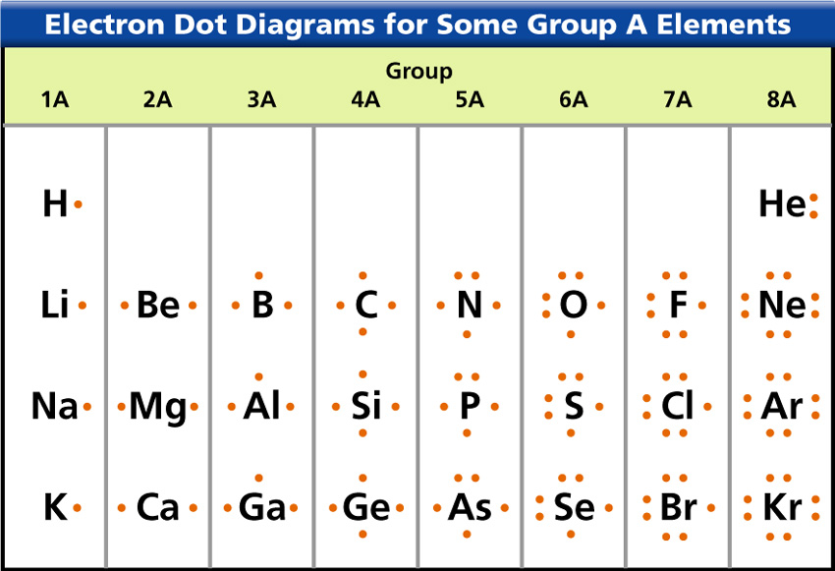

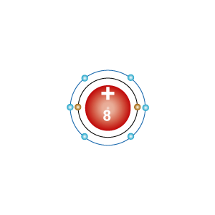
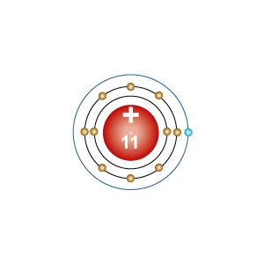
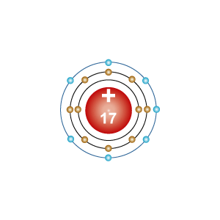
Valence electrons: Do the Bonding

Slide 13
Types of Chemical Bonds
There are two main ways atoms achieve eight valence electrons.
Atoms can swap valence electrons or share them.
Therefore, there are two types of bonds that you need to know.
Ionic bonds = When metals and non-metals SWAP electrons creating ions of opposite charge that attract.
Covalent bonds = When atoms SHARE electrons to create molecules.

Slide 14
Types of Combinations
Atoms can combine with atoms of the same element or different elements.
When atoms of the same element bond they always covalently bond and form what’s known as a molecule.
More specifically, a molecule is two or more atoms, the same OR different, covalently bonded together.
When atoms of different elements combine, a compound forms.
A compound is a substance made of the bonded atoms of two or more different elements.

Slide 15
Molecules or Compounds
We generally only refer to bonded groups of atoms as molecules or compounds, not both, even though they can be.
For example;
Molecules can have only one type of element involved, but compounds always have more than one element involved.
So, a substance like H₂O can be considered a compound, but it’s also a molecule because there is two elements involved.
O₂, on the other hand, is only a molecule and can never be called a compound.

Slide 16
Molecules or Compounds
Moreover, the result of a covalent bond always forms molecules and sometimes compounds but ionic bonds never result in molecules.
As well, ionic bonds will always form compounds.
The reason is you will never see an element lose electrons to itself.

Slide 17
Ionic Bonds
When atoms combine with each other due to the attraction of oppositely charged ions.

Slide 18
Ionic Compounds
Ionic Bonding
Atoms can sometimes achieve a stable valence level by losing or gaining electrons.
When an atom’s electron numbers don’t match the proton number the charge of the atom changes slightly and an ion is formed.
An ion is an atom or group of atoms that has an electric charge because it has gained or lost electrons.
Opposite charges attract.
The attractive force between oppositely charged ions results in an ionic bond.

Slide 19
Forming Ions
You should remember that protons and electrons have charges.
Protons + Electrons –
Normally, neutral atoms positive and negative charges balance each other out.
An element will never lose protons because they are in the nucleus.
Electrons, however, are flying around and can migrate from atom to atom.
When an atom gains or loses electrons, the overall charge associated with the atom is affected, forming ions of different charges.

Slide 20
How Do You Know How Electrons Get Exchanged?
It is all based upon the number of valence electrons for the element in its basic form.
First, ionic bonds generally only form when metals and non-metals interact.
  This means that metals won’t ionic bond with metals and & non-metals will not ionic bond with non-metals.
When metals interact with non-metals, the general question to ask is “will it be easier to give away the electrons or get electrons?”
This will tell you which direction the electrons are going to go.
As it is, the metals on the left usually give electrons because they are closer to 8 if they lose a few.
The non-metals on the right usually gain electrons because they will achieve 8 if they gain just a few.
This is why when metals and non-metals bond they usually form ionic compounds.

Slide 21

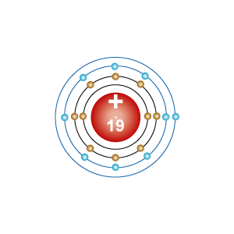
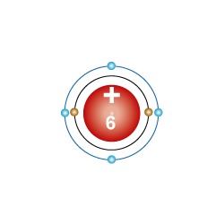
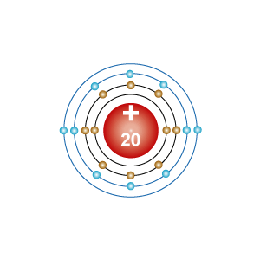
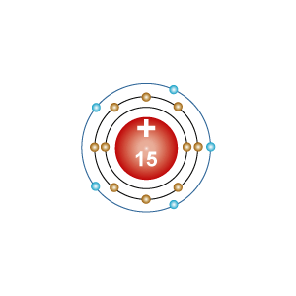
Find These Elements on you Periodic Table
Loses e-
Gains e-
Carbon
Gains or
Loses e-
How close are these elements to achieving 8 in their valence shell?
Is it faster to gain a few or lose a few?
The numbers of e- gained/lost are variable & correspond to how many they need.
What about carbon?

Slide 22
Formation of Ions: Count the p+ & e- before & after the exchange…
+
-
Na
Cl
Sodium | Before | After | Chlorine | Before | After
Protons | +11 | +11 | Protons | +17 | +17
Electrons | -11 | -10 | Electrons | -17 | -18
Total | 0 | +1 | Total | 0 | -1

Slide 23
Complete this chart in your notes
 |  |  | Charge before | Quicker to lose or gain? How many? | # Electrons in the energy level immediately below valence | Charge after | Oxidation number
Sodium | Protons
 | Electrons
 | Total Charge
Chlorine | Protons
 | Electrons
 | Total Charge
Calcium | Protons
 | Electrons
 | Total Charge
Oxygen | Protons
 | Electrons
 | Total Charge

Slide 24
Forming Ions. Terms
Ions have different names depending on whether it forms a positive or negative ion.
A positive ion is called a cation.
A negative ion is called an anion.

Slide 25
Complete this chart in your notes
 |  |  | Charge before | Quicker to lose or gain? How many? | # Electrons in the energy level immediately below valence | Charge after | Oxidation number
Sodium | Protons
 | Electrons
 | Total Charge
Chlorine | Protons
 | Electrons
 | Total Charge
Calcium | Protons
 | Electrons
 | Total Charge
Oxygen | Protons
 | Electrons
 | Total Charge

Slide 26
Formation of Ions:
Oxidation Number
Not all elements lose or gain just one electron.
Some, as with the case of magnesium or oxygen, gain or lose 2.
Some are three.
The charge associated with the atom once it has lost or gained electrons is called it’s oxidation number.
An oxidation number is a number assigned to an element in chemical combination that represents the number of electrons lost or gained by an atom of that element in the compound.

Slide 27
Oxidation Number, Continued.
The point of ionic bonds is to balance charges.
The oxidation number tells you how many electrons the ion either has in excess or needs, allowing you to predict the number of other atoms this ion will need to bond with in order to balance the ion’s charge.
For example, magnesium loses 2 electrons when it forms an ion.
It gains a +2 charge by losing 2 electrons.
Its oxidation number is then +2.
This lets you know that magnesium will need to make a bond with enough atoms to balance out the +2 charge.
This could be 1 atom with a -2 charge or
This could be with 2 atoms with a -1 charge.

Slide 28
Complete this chart in your notes
 |  |  | Charge before | Quicker to lose or gain? How many? | # Electrons in the energy level immediately below valence | Charge after | Oxidation number
Sodium | Protons
 | Electrons
 | Total Charge
Chlorine | Protons
 | Electrons
 | Total Charge
Calcium | Protons
 | Electrons
 | Total Charge
Oxygen | Protons
 | Electrons
 | Total Charge

Slide 29
Complete this chart in your notes
 |  |  | Charge before | Quicker to lose or gain? How many? | # Electrons in the energy level immediately below valence | Charge after | Oxidation number
Sodium | Protons | 11 | 0 | lose 1 | 8 | +1 | +1
 | Electrons | 11
 | Total Charge | 0
Chlorine | Protons | 17 | 0 | gain 1 | 8 | -1 | -1
 | Electrons | 17
 | Total Charge | 0
Calcium | Protons | 20 | 0 | lose 2 | 8 | +2 | +2
 | Electrons | 20
 | Total Charge | 0
Oxygen | Protons | 8 | 0 | gain 2 | 2 | -2 | -2
 | Electrons | 8
 | Total Charge | 0

Slide 30

How Do You Show the Bond?
Ionic
Bohr Model
Or…
We use Lewis Structures which only show the valence electrons.
Lewis Structure

Slide 31
B1: The bonding of Na with Cl
Start with Lewis Structures of the elements involved
Determine the metal and the nonmetal from the PTE.
Figure out how many electrons the metal (sodium here) loses.
Figure out how many electrons the nonmetal (chlorine here) need
Balance uneven numbers.
Draw the arrow from the metal(s) to the nonmetal(s) showing the electron moving.
Draw in the “+” and “-” signs and the oxidation number associated with the newly formed ion as a result of the number of electrons given or received.
Lewis Structure

Slide 32
B1: The bonding of Na with Cl
Start with Lewis Structures of the elements involved.
Lewis Structures: Just the symbol surrounded by the valence electrons.
Lewis Structure

Slide 33
B1: The bonding of Na with Cl
Start with Lewis Structures
Determine the metal and the nonmetal from the PTE.
METAL: The one giving the electron(s)
NONMETAL: The one receiving the electron(s)
Lewis Structure

Slide 34
B1: The bonding of Na with Cl
Start with Lewis Structures
Determine the metal and the nonmetal from the PTE.
Figure out how many electrons the metal (sodium here) loses.
Sodium has 1 valence electron so it will lose 1
Lewis Structure

Slide 35
B1: The bonding of Na with Cl
Start with Lewis Structures
Determine the metal and the nonmetal from the PTE.
Figure out how many electrons the metal (sodium here) loses.
Figure out how many electrons the nonmetal (chlorine here) need
Chlorine has 7 valence electrons to it will need 1.
Lewis Structure

Slide 36
B1: The bonding of Na with Cl
Start with Lewis Structures of the elements involved
Determine the metal and the nonmetal from the PTE.
Figure out how many electrons the metal (sodium here) loses.
Figure out how many electrons the nonmetal (chlorine here) need
Balance uneven numbers.
Lewis Structure

Slide 37
B1: The bonding of Na with Cl
5. Balance uneven numbers.
Sodium is giving one and chlorine is needing one, the numbers balance, meaning there are as many Lewis Structures for both…
The necessary metals to give electrons and…
The necessary nonmetals for accepting the electrons.
If these are not balanced you need to add either metals or nonmetals to balance.
Lewis Structure

Slide 38

B1: The bonding of Mg with F
5. Balance uneven numbers.
In this case we are trying to diagram MgF₂
The necessary metals to give electrons and…
Magnesium has 2 valence electrons, so it needs to find 2 open spots on another element.
The necessary nonmetals for accepting the electrons.
Fluorine needs just 1 valance electron, but there are 2 needing homes.
If these are not balanced you need to add either metals or nonmetals to balance.
To balance this, you add enough metals or nonmetals (their Lewis Structures) to create either electron donors or acceptors to make the bond work.
What do I need to do here?
ADD ONE MORE FLOURINE TO ACCEPT MAGNESIUM’S OTHER ve-

Slide 39
B1: The bonding of Na with Cl
Start with Lewis Structures of the elements involved
Determine the metal and the nonmetal from the PTE.
Figure out how many electrons the metal (sodium here) loses.
Figure out how many electrons the nonmetal (chlorine here) need
Balance uneven numbers.
Draw the arrow from the metal(s) to the nonmetal(s) showing the electron moving.
Lewis Structure

Slide 40
B1: The bonding of Na with Cl
Start with Lewis Structures of the elements involved
Determine the metal and the nonmetal from the PTE.
Figure out how many electrons the metal (sodium here) loses.
Figure out how many electrons the nonmetal (chlorine here) need
Balance uneven numbers.
Draw the arrow from the metal(s) to the nonmetal(s) showing the electron moving.
Draw in the “+” and “-” signs and the oxidation number associated with the newly formed ion as a result of the number of electrons given or received.
Lewis Structure

Slide 41
B1: The bonding of Na with Cl
The difference between NaCl and MgF₂
+
-
+ 2
-
-

Slide 42
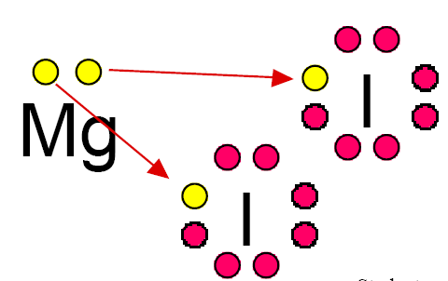
Example: MgI₂
+2
I
-1
I
-1
WHY?

Slide 43
Daigraming B2: Example: MgI₂
Oxidation Number +2 / -1
+2
I
-1
I
-1
WHY?

Slide 44
Magnesium chloride. (Just like B2): Since Magnesium donated 2 electrons what should its charge be?
Since each chlorine received one electron what should each charge be?
+2
Cl
-1
Cl
-1
When Magnesium loses its outer electrons it exposes its next lower energy level, which happens to have 8 electrons.

Slide 45
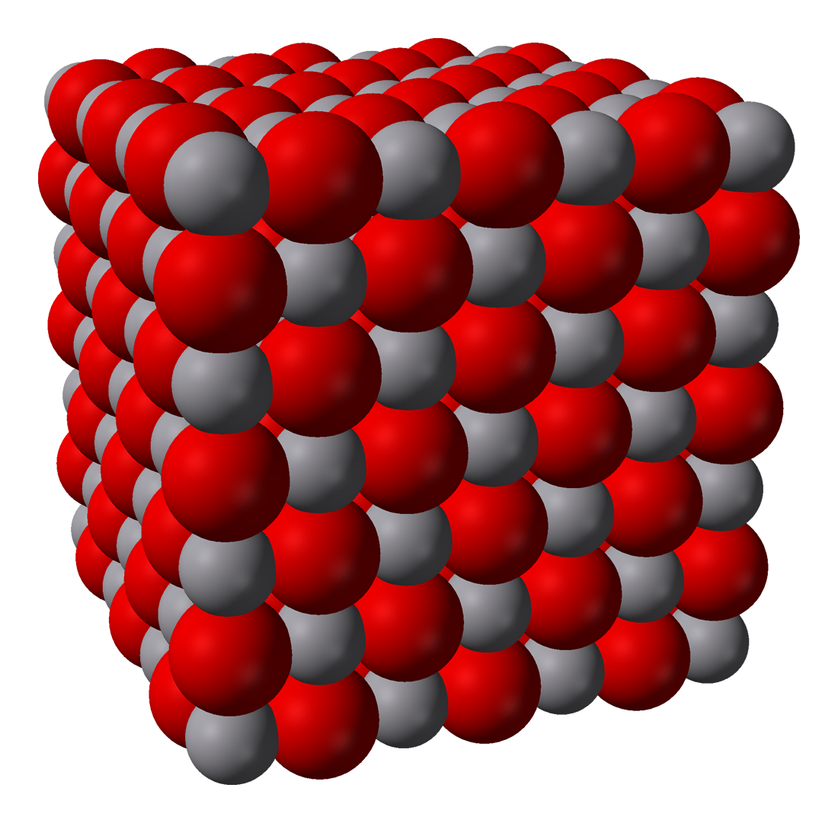
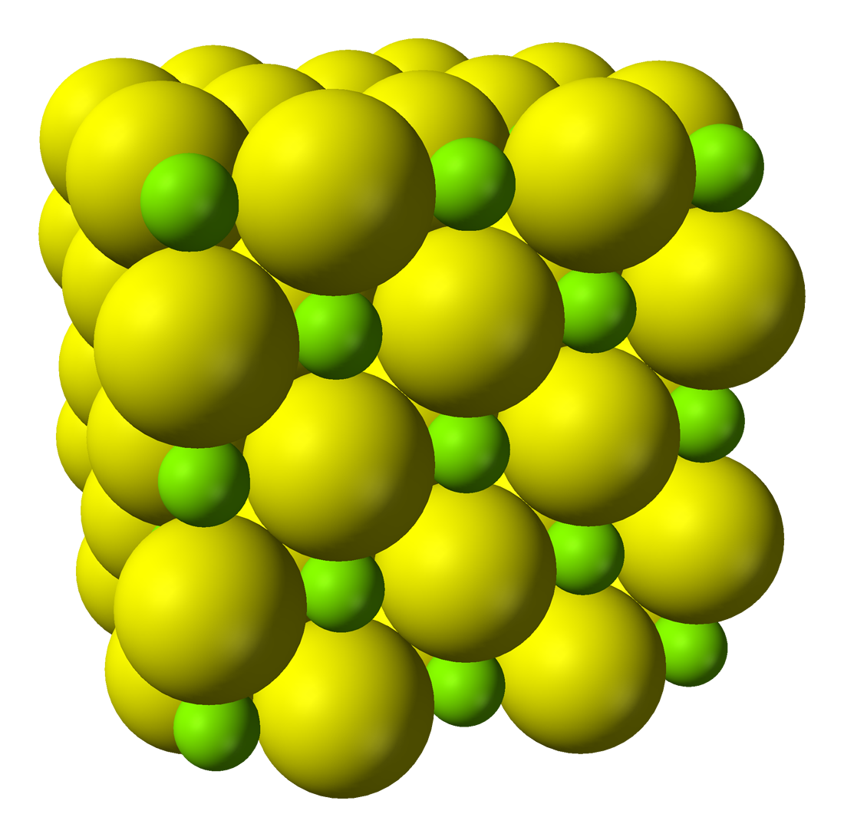
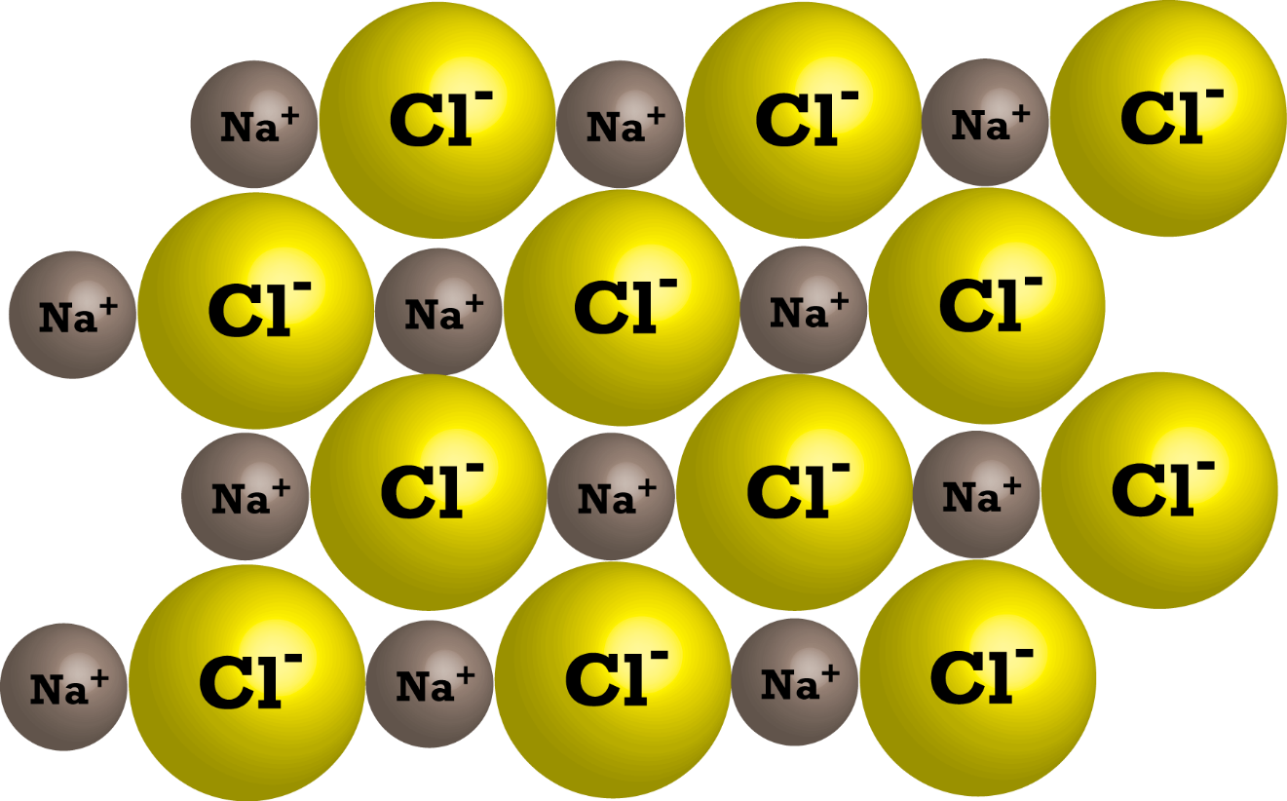
Ionic Bonds and Crystals
Based upon the interactions of the ions in ionic compounds, often these form crystals.
Crystals are built off of a repeating sequence of oppositely-charged ions bonded to one another, forming a lattice.

Slide 46
Chemical Bonds, continued
Covalent Bonding
Besides swapping (an electron leaves one atom and migrates to another), another way that atoms bond is by sharing valence electrons in a covalent bond.
In covalent bonds, sharing is always equal; meaning that if atoms share electrons they are always done in pairs. For every one electron shared by one atom it gets one back from another in return.
As stated previously, sharing electrons results in what are called molecules.
A water molecule, H₂O, forms when an oxygen atom forms covalent bonds with two hydrogen atoms.

Slide 47



Poor Oxygen…
Ah, he’s sad because his valence shell isn’t filled.
If there was only some way to get more.
Wait. Hey sad oxygen buddy. If we shared some electrons, then we could both have 8…kinda.
Now we both can have eight!
Sometimes… and that’s enough and the reason to form a covalent bond.

Slide 48


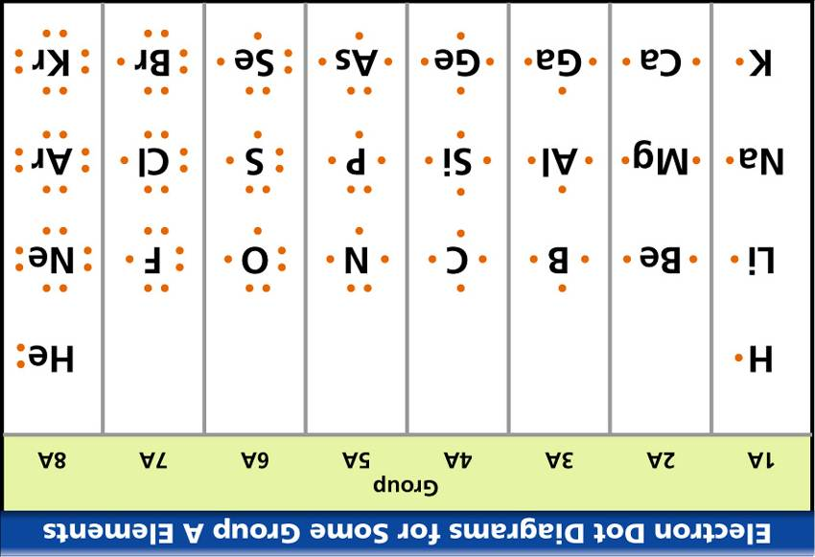

How Do You Show the Covalent Bonds?
Bohr Model
Lewis Structure
Or…

Slide 49
Illustrate the bonding of 2H + O to make H₂O
Lewis Structures are much easier to use to illustrate the bonds between atoms in a covalent bond.
Let’s work through how…

Slide 50
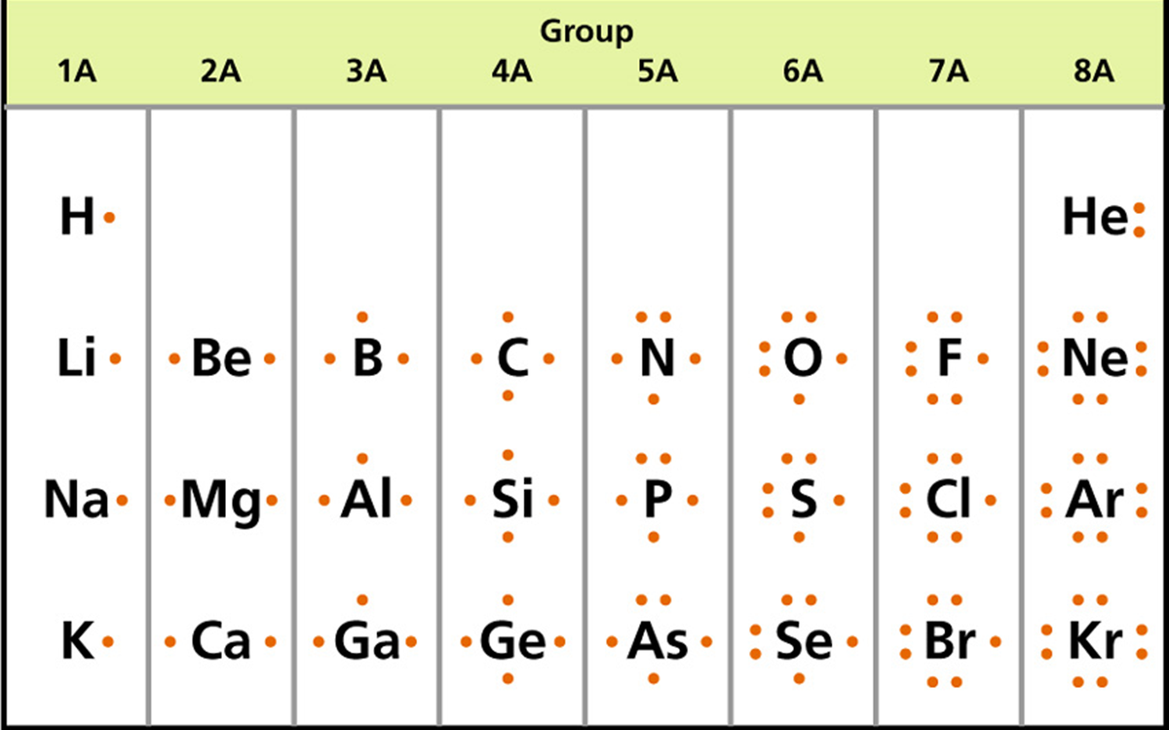
C2: The bonding of 2 Hydrogen & Oxygen
Start with Lewis Structures of the elements involved
Determine how many electrons are necessary to complete the involved elements’ valence shells.
Draw a circle around the individual elements so that all involved elements are given their adequate amount of valence electrons.
Clean up the drawing if necessary.

Slide 51

C2: The bonding of 2 Hydrogen & Oxygen
Start with Lewis Structures of the elements involved.
Understand that you have a lot of flexibility in how Lewis Structures are created. Think ahead before you start drawing your dots so they line up cleaner. You’ll be messy at first, but with some practice you’ll get cleaner and neater. It is definitely important to use different symbols for electrons from different elements.

Slide 52
C2: The bonding of 2 Hydrogen & Oxygen
Start with Lewis Structures of the elements involved
Determine how many electrons are necessary to complete the involved elements’ valence shells.
Remember, Hydrogen only has one energy level [ring] and only needs 2 to have a complete valence shell
Needs 1?
Needs 1
Needs 2

Slide 53
C2: The bonding of 2 Hydrogen & Oxygen
Start with Lewis Structures of the elements involved
Determine how many electrons are necessary to complete the involved elements’ valence shells.
Draw a circle around the individual elements so that all involved elements are given their adequate amount of valence electrons.
At this point everything is done, however you must check your work by counting the numbers of electrons in each circle. If Hydrogen has its 2 and Oxygen has its 8 then you are technically good (though it’s messy).

Slide 54



C2: The bonding of 2 Hydrogen & Oxygen
Start with Lewis Structures of the elements involved
Determine how many electrons are necessary to complete the involved elements’ valence shells.
Draw a circle around the individual elements so that all involved elements are given their adequate amount of valence electrons.
Clean up the drawing if necessary.
Instead of drawing your electrons anywhere, try to anticipate where the electrons will go and draw you structures accordingly. Generally, the element with the most individual electrons to gain will go in the middle. There are rules to this, but we are just going over the basics today. We could draw these like this, but it got messy. Look what happens when we move things around a bit.
Electrons are missing here so let’s redraw with the elements in more convenient placement.

Slide 55
C2: The bonding of 2 Hydrogen & Oxygen
Start with Lewis Structures of the elements involved
Determine how many electrons are necessary to complete the involved elements’ valence shells.
Draw a circle around the individual elements so that all involved elements are given their adequate amount of valence electrons.
Clean up the drawing if necessary.
Here is the same diagram, just cleaned up.

Slide 56
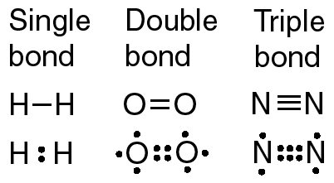
Covalent Bonds & Electrons
As stated before, electrons shared in a covalent bond are always in pairs.
This pair forms one covalent bond.
Sometimes, the sharing between particular atoms will only be accomplished if multiple pairs of electrons are shared.
This results in alternative types of bonds:
Single
Double or
Triple

Slide 57
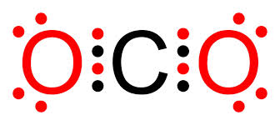
Example C5: C0₂

Slide 58
Practice
Complete the Bonding Basics practice.
Section A: Complete the chart using your periodic table and notes.
Answer the questions, using notes.
Diagram the samples B1 thru B6
Complete Section C, answer the questions and diagram examples C1 thru C6.
When complete, answer the questions on the Bonding Concepts follow up worksheet.

